Slide 1
var array = new int[8];
array
0
0
0
0
0
0
0
0
var span = new Span<int>(array, 2, 3);
array
0
0
0
0
0
0
0
0
span
span[i] = 1;
array
0
0
1
1
1
0
0
0
span

Slide 2
s
a
b
c
あ
い
う
亜
以
宇
(コピー)
span
(参照)
sub
あ
い
う

Slide 3
struct ArraySegment<T>
{
T[] Array;
int Offset;
int Count;
}
配列
Array
0
0
0
0
0
0
0
0
配列自体
を参照
Offset
Count
struct Span<T>
{
ref T Reference;
int Length;
}
配列
0
0
0
0
0
0
0
0
Length
Reference

Slide 4
using System;
public class Program
{
static void Main()
{
var x = new Int32();
var y = new String(' ', 1);
}
}
using System;
public class Program
{
static void Main()
{
var x = new Int32();
var y = new String(' ', 1);
}
}

Slide 5
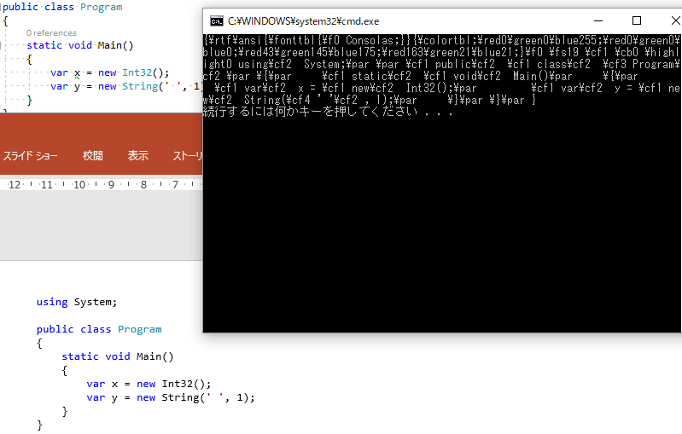
get RTF data from clipboard
2B91AF
Copy
\cf2 is black
Paste
Black

